Slide 1
Speech Essentials
Things one needs to know for giving an awesome speech and getting a high EOC score!

Slide 2

Summary, Critique, Paraphrasing

Slide 3
Summary
Definition: Condensing an author’s ideas to a more succinct statement
Ways to avoid plagiarism:
· Use a signal or identifying phrase that tells who and what you are summarizing.
· Use a quick description of the main points of the passage.
· Use your own words and phrasing. In most cases, avoid using any of the same wording.
· Add an intext (parenthetical) reference at the end of the summary.
· Include a citation at the end of your paper (Works Cited).

Slide 4
SUMMARY EXAMPLE
MLA Example:
Original passage:
By 1964, there were an estimated 33,500 restaurants in the United States calling themselves “drive-ins,” but only 24,500 offered hot food, the remainder being ice cream and soft drink stands primarily. Layout varied from drive-in to drive-in, but three principal spaces could always be found: a canopy covered driveway adjacent to the building, a kitchen, and a carhop station linking kitchen and parking lot. The smallest drive-ins offered carhop service only, but many also featured indoor lunch counters and booths, sometimes on the scale of the coffee shop.

Slide 5
SUMMARY EXAMPLE
In the chapter “QuickService Restaurants in the Age of Automobile Convenience,” The authors note that by the mid 1960s, nearly 35,000 self proclaimed “drive-in” restaurants in the United States existed. No specific blueprint defined the typical drive-in; however, three characteristics describe this new type of casual eating establishment: a covered driveway, a kitchen, and a carhop station (Jackle and Sculle 55).

Slide 6
Critique
An analysis or evaluation of a text, production, or performance.
Similar to summary in that it identifies main point, looks at questions, and reviews results.
A critique adds the writer’s OWN analysis and evaluation.
It does not mean that the author only points out flaws!

Slide 7
Paraphrasing
involves putting a passage from source material into your own words.
A paraphrase must also be attributed to the original source.
Paraphrased material is usually shorter than the original passage, taking a somewhat broader segment of the source and condensing it slightly.
HINT: THIS IS WHAT MOST STUDENTS DO, AND THEN CLAIM IT ISN’T PLAGIARISM! IT IS!!!!!!

Slide 8
PARAPHRASING EXAMPLE
MLA Example:
Original passage:
Annie Oakley's life spanned years of tremendous change for American women. By the time of her death in 1926, Americans were celebrating the liberated, urban focused, modern times of the Jazz Age. Women had won the right to vote, wore less restrictive clothes, and followed a changing ideal that was loosening some of the restrictions on women's roles and behavior that had reigned through the nineteenth century.

Slide 9
PARAPHRASING EXAMPLE
Correct paraphrasing:
As discussed in the biography on PBS’s American Experience web page, sharpshooter Annie Oakley lived through a period of many liberating changes for women, from the Victorian era through the first quarter of the 20th century. Examples include voting rights for women as well as the freedom to wear comfortable and practical clothing (Annie Oakley).

Slide 10
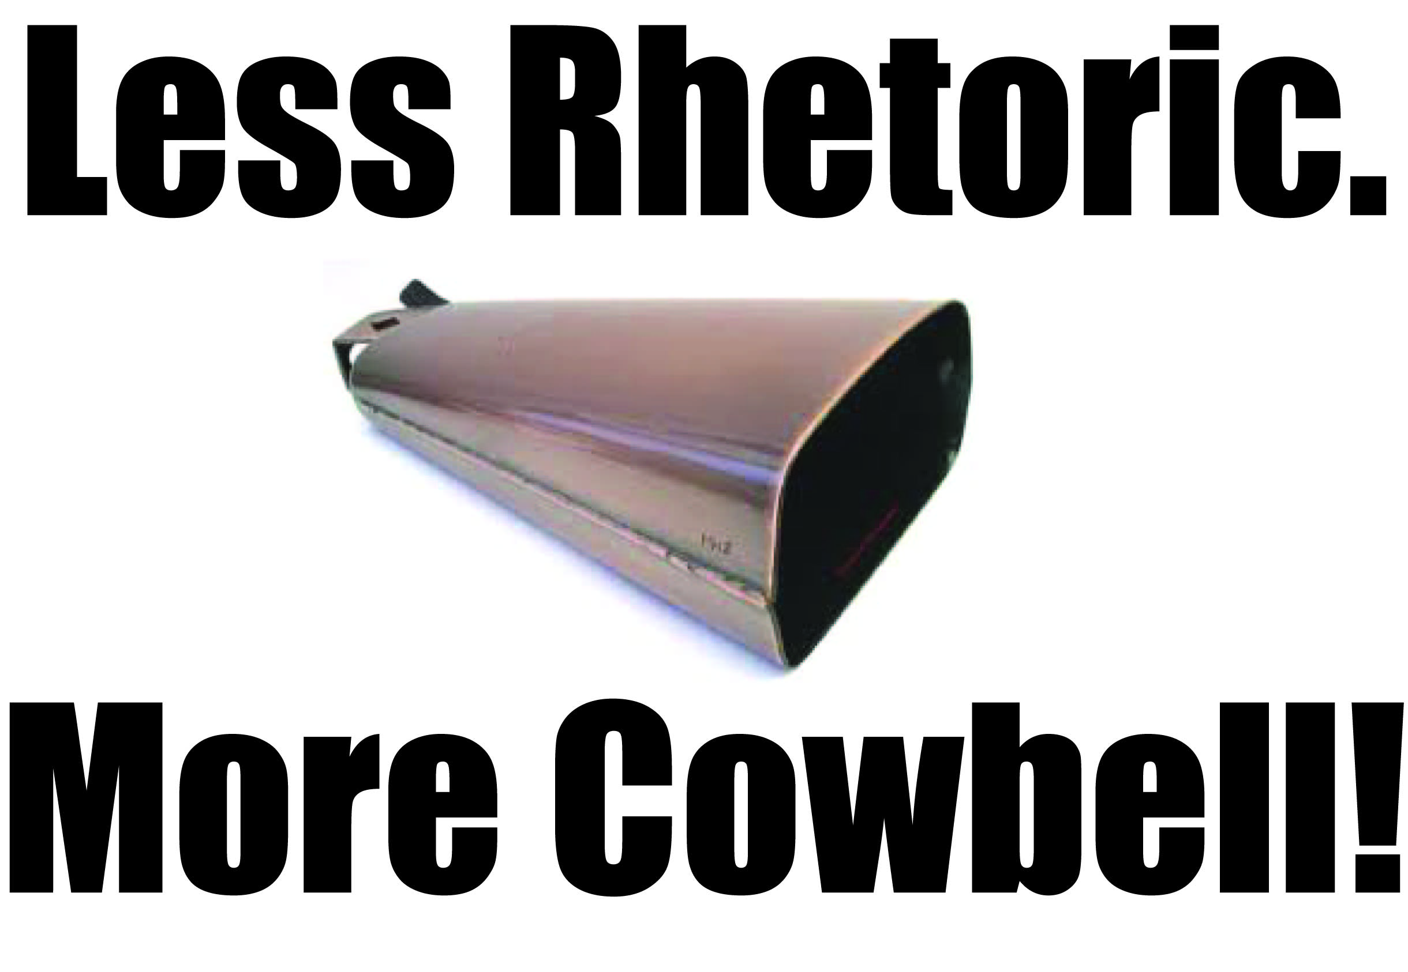
RHETORIC 101

Slide 11
The rhetoric of today
http://www.youtube.com/watch?v=pKyIw9fs8T4
“Totally Like Whatever” by Taylor Mali

Slide 12
Rhetoric =
The manipulation of language for an intended effect
Political Speeches
Love letters
Text messages
Memoirs
Literature
Poetry
Song lyrics
Lectures
Pamphlets
Comic Books
Protest signs
Bumper Stickers

Slide 13
Alliteration
the repetition of the same sound at the beginning of a word
Keats’s “beaded bubbles winking at the brim” (“Ode to a Nightingale”)

Slide 14
Assonance
the repetition of vowel sounds
please-niece-ski-tree

Slide 15
Onomatopoeia
a word whose sounds seem to duplicate the sounds they describe
–hiss, buzz, bang, murmur, meow, growl.

Slide 16
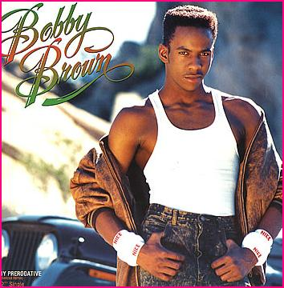
REPETITON/ANAPHORA
Anaphora: Repeating a phrase at the beginning of each clause.
Every little step I take, you will be there
Every little step I make, we'll be together
Every little step I take, you will be there
Every little step I make, we'll be together –Bobby Brown “Every Little Step”

Slide 17
Anaphora
Repetition of the same word or group of words at the beginning of successive clauses, sentences, or lines.
"We shall go on to the end, we shall fight in France, we shall fight on the seas and oceans, we shall fight with growing confidence and growing strength in the air, we shall defend our Island, whatever the cost may be, we shall fight on the beaches, we shall fight on the landing grounds, we shall fight in the fields and in the streets, we shall fight in the hills; we shall never surrender."
(Winston Churchill, speech to the House of Commons, June 4, 1940)

Slide 18
Epistrophe
The repetition of a word or phrase at the end of successive clauses.
"For no government is better than the men who compose it, and I want the best, and we need the best, and we deserve the best."
(Senator John F. Kennedy, speech at Wittenberg College, Oct. 17, 1960)

Slide 19
Metaphor
a comparison of two dissimilar things which does not use “like” or “as,”
What light through yonder window breaks?
It is the east, and Juliet is the sun…(Romeo)

Slide 20
Simile
a comparison of two dissimilar things using “like” or “as”
"Humanity, let us say, is like people packed in an automobile which is traveling downhill without lights at terrific speed and driven by a four-year-old child. The signposts along the way are all marked 'Progress.'"
(Lord Dunsany

Slide 21
Personification
A figure of speech in which an inanimate object or abstraction is given human qualities or abilities.
"Pimento eyes bulged in their olive sockets. Lying on a ring of onion, a tomato slice exposed its seedy smile . . .."
(Toni Morrison, Love: A Novel. Alfred A. Knopf, 2003)
"The only monster here is the gambling monster that has enslaved your mother! I call him Gamblor, and it's time to snatch your mother from his neon claws!"
(Homer Simpson, The Simpsons)
"Fear knocked on the door. Faith answered. There was no one there."
(proverb quoted by Christopher Moltisanti, The Sopranos)

Slide 22
Allusion
A brief, usually indirect reference to a person, place, or event--real or fictional.
"I was not born in a manger. I was actually born on Krypton and sent here by my father, Jor-el, to save the Planet Earth."
(Senator Barack Obama, speech at a fund-raiser for Catholic charities, October 16, 2008)

Slide 23
Oxymoron
seemingly contradictory terms appear side by side
O brawling love! O loving hate! . . .
O heavy lightness! serious vanity!
Misshapen chaos of well-seeming forms!
Feather of lead, bright smoke, cold fire, sick health!
Still-waking sleep, that is not what it is!
This love feel I, that feel no love in this."
(William Shakespeare, Romeo and Juliet)
Civil war
Real phony
Pretty disgustin

Slide 24
Litotes
understatement in which an affirmative is expressed by the negative of the contrary
as in “not a bad singer” or “not unhappy”
"Oh, you think you're so special because you get to play Picture Pages up there? Well, my five year old daughter could do that and let me tell you, she's not the brightest bulb in the tanning bed."
(Allison Janney as Bren in Juno, 2007)

Slide 25
Rhetorical Question
a question is "rhetorical" if it is asked merely for effect with no answer expected.
"If practice makes perfect, and no one's perfect, then why practice?"
(Billy Corgan)
"Isn't it a bit unnerving that doctors call what they do 'practice'?"
(George Carlin)
Grandma Simpson and Lisa are singing Bob Dylan's "Blowin' in the Wind" ("How many roads must a man walk down/Before you call him a man?"). Homer overhears and says, "Eight!"
Lisa: "That was a rhetorical question!"
Homer: "Oh. Then, seven!"
Lisa: "Do you even know what 'rhetorical' means?"
Homer: "Do I know what 'rhetorical' means?"
(The Simpsons,

Slide 26
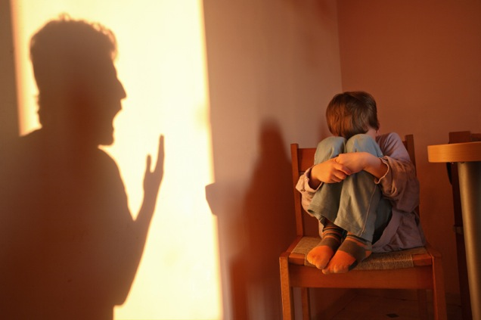
Rhetorical question
“How many times are you going to make the same mistake before you get it through your thick skull?!?”

Slide 27
Hyperbole
exaggeration is used for emphasis or effect; an extravagant statement
"My toaster has never once worked properly in four years. I follow the instructions and push two slices of bread down in the slots, and seconds later they rifle upwards. Once they broke the nose of a woman I loved dearly."
(Woody Allen, "My Speech to the Graduates." The New York Times, Aug. 10, 1979)
"I'm experienced now, professional. Jaws been broke, been knocked down a couple of times, I'm bad! Been chopping trees. I done something new for this fight. I done wrestled with an alligator. That's right. I have wrestled with an alligator. I done tussled with a whale. I done handcuffed lightning, thrown thunder in jail. That's bad! Only last week I murdered a rock, injured a stone, hospitalised a brick! I'm so mean I make medicine sick!"
(Muhammad Ali in the documentary film When We Were Kings, 1996)

Slide 28
Metonymy and Synedoche
Synecdoche: using a part to represent a whole. I asked for her hand in marriage.
Metonymy: using a closely related object as a substitute for the object or idea in mind. Those orders came directly from the crown.

Slide 29
Understatement
a writer or speaker deliberately makes a situation seem less important or serious than it is.
"The grave's a fine and private place,
But none, I think, do there embrace."
(Andrew Marvell, "To His Coy Mistress")
"Well, that's cast rather a gloom over the evening, hasn't it?"
(Dinner guest, after a visit from the Grim Reaper, in Monty Python's The Meaning of Life)
"I am just going outside and may be some time."
(Captain Lawrence Oates, Antarctic explorer, before walking out into a blizzard to face certain death, 1912)

Slide 30
Parrallelism
using the same pattern of words to show that two or more ideas have the same level of importance.
"When you are right you cannot be too radical; when you are wrong, you cannot be too conservative."
(Martin Luther King, Jr.)
"Our transportation crisis will be solved by a bigger plane or a wider road, mental illness with a pill, poverty with a law, slums with a bulldozer, urban conflict with a gas, racism with a goodwill gesture."
(Philip Slater, The Pursuit of Loneliness)
"Today's students can put dope in their veins or hope in their brains. If they can conceive it and believe it, they can achieve it. They must know it is not their aptitude but their attitude that will determine their altitude."
(Jesse Jackson)

Slide 31
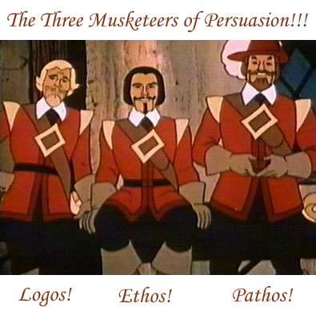
ETHOS, PATHOS, LOGOS
Ethical, emotional, and logical arguments.

Slide 32
Pathos
The means of persuasion that appeals to the audience’s emotions
"A brilliant young woman I know was asked once to support her argument in favor of social welfare. She named the most powerful source imaginable: the look in a mother's face when she cannot feed her children. Can you look that hungry child in the eyes? See the blood on his feet from working barefoot in the cotton fields. Or do you ask his baby sister with her belly swollen from hunger if she cares about her daddy's work ethics?"
(Nate Parker as Henry Lowe in The Great Debaters, 2007

Slide 33
Ethos
A persuasive appeal based on the writer or speaker’s character or projected character.
"The personality of the orator outweighs the issues."
(John Leopold)
"I'm not a doctor, but I play one on TV."
(1960s TV commercial for Excedrin)
What is more reliable? Information about lung research on the American Lung Assoication website, or from a Facebook profile page?

Slide 34
Logos
The means of persuasion based on the truth, or apparent truth.
Statistics
Surverys
RELIABLE INFORMATION FROM RELIABLE SOURCES.
“Mom, it is proven that cell phones can save lives in emergency situations.”

Slide 35
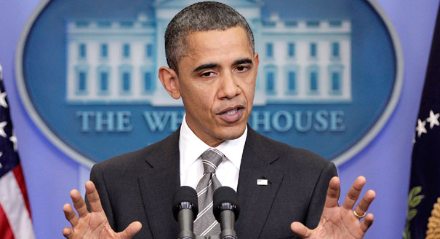
ACTIVE vs. PASSIVE VOICE
“Mistakes were made…”

Slide 36

ANTIMETABOLE/CHIASMUS
Antimetabole: Repetition of words in successive clauses but transposed in grammatical order
“The rhythm is the bass and the bass is the treble” --Warren G
Chiasmus: Transposed grammar only
“He knowingly led and we followed blindly“ (adverb/verb; verb/adverb)

Slide 37
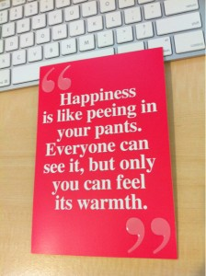
ANALOGY

Slide 38
Citations
http://owl.english.purdue.edu/owl/resource/623/1/
http://grammar.about.com

